Slide 1
UNIT – IV
Memory System Design
Semiconductor memory technologies
SRAM vs DRAM
Memory Organization
Memory interleaving
Concepts of hierarchical memory organization
Cache memory
Cache size vs block size
Mapping functions
Replacement algorithms
Write policies
Virtual memory
Secondary storage

Slide 2
Memory
Programs and data they operate on are held in the memory of the Computer.
The execution speed of the programs is highly dependent on the speed with which instructions and data are transferred between processor and memory.
It is also important to have enough memory to facilitate execution of large programs with large data.
Ideally, memory should be large fast and inexpensive which is not possible as increased speed and size are achieved at increased cost.
Computer memory has hierarchy, including a cache, main memory and secondary storage.
Maximum size of memory that a computer can use is determined by the addressing scheme.
Ex: Computer that generates 16-bit addresses is capable of addressing upto 2¹⁶ memory locations(64K). The number of locations represent the size of computer address space.
The connection between CPU and memory consists of address, data and control lines.

Slide 3

Address lines: specify memory location involved in data transfer operation.
Data lines: transfer the data
Control lines: carry commands to indicate RD or WR operation. Also, provide timing information.
The CPU of a computer can process instructions and data faster than they can be fetched from the main memory.
Hence, memory access time is the bottleneck in the systems.
Techniques to reduce access time are to use cache memory, Virtual memory…

Slide 4
Memory – Characteristics
The memory system can be characterized with
Location: Where it can be located - Internal(Processor registers, cache, main memory)or External-(magnetic disks, tapes) .
Capacity: size in terms of bytes - KB, MB, GB, etc..
Unit of transfer: How many bits can be moved like bytes, words, Blocks, etc..
Access method: How you pick data - Sequential, Direct, Random, etc..
Performance: Access rate, Transfer rate in terms of bps
Physical type: Which material we are using like semiconductor, Magnetic, Optical, etc..
Physical characteristics: power consumption, information loss, volatile/non-volatile etc..
Organization: How it stored like continuous, interleaved, etc..

Slide 5
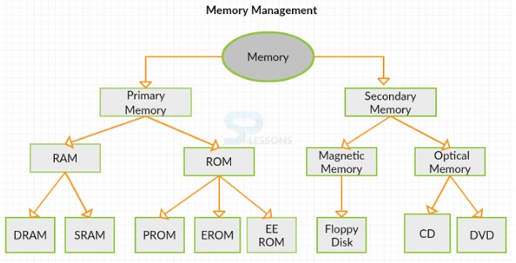
Computer Memory

Slide 6
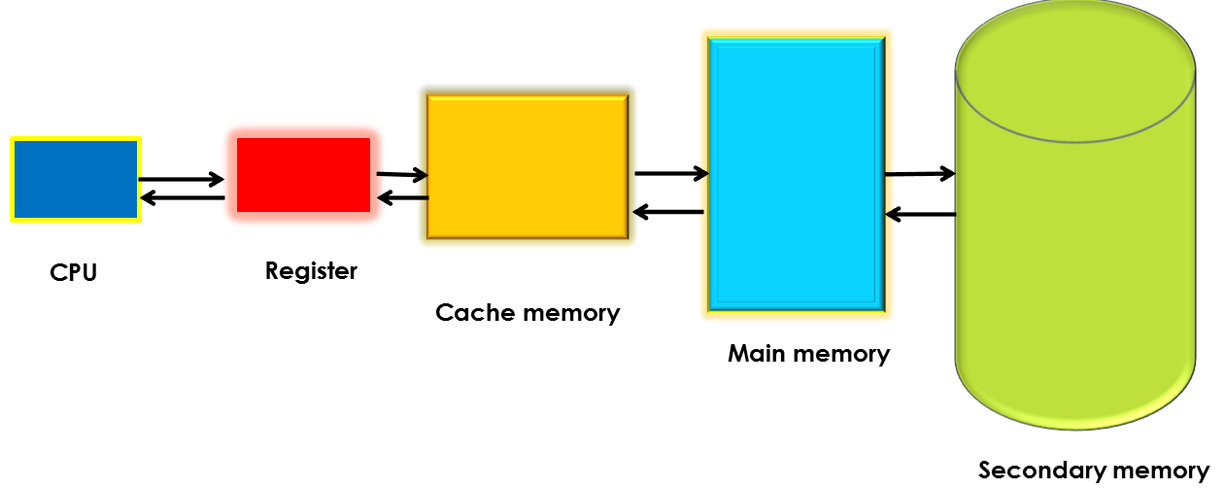
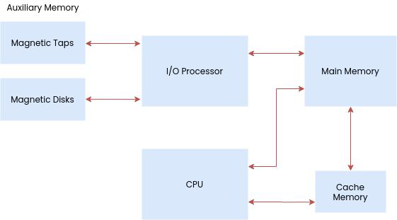
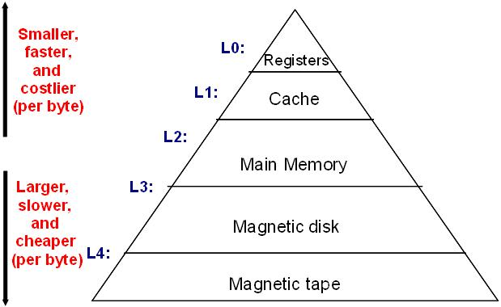
Memory Hierarchy
Memory hierarchy consists of all storage devices employed in a computer system from the slow but high capacity auxiliary memory to a relatively faster main memory, to an even smaller and faster cache memory accessible to the high speed processing logic.

Slide 7
Memory Hierarchy
Auxiliary memory
Magnetic
tapes
I/O
Main
processor
memory
Magnetic
disks
CPU
Cache
memory
Register
Cache
Main Memory
Magnetic Disk
Magnetic Tape

Slide 8
Memory Hierarchy
Registers
  Internal to the processor
  Processor contains few dozen register to hundreds of registers
  Cache
  Very high speed memory that holds data and programs that are mostly used by the CPU.
  Used to compensate the speed difference between main memory access time and processor logic.
  Its access time is close to processor logic clock cycle time.
  Main memory
  Primary internal memory of the computer.
  Communicates directly with the CPU.
  Communicates with auxiliary memory through I/O processor
  Usually extended with a high-speed, smaller cache.
  Auxiliary memory - provide backup storage. Ex: Magnetic disks and magnetic tapes
  Used for storing system programs, large data files and other backup information.
  Holds information that is not currently used by CPU and transferred to main memory when needed.
  Goal : obtain highest possible average access speed with minimal cost of entire memory system

Slide 9
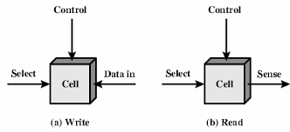
Semiconductor Main memory
Main memory - central unit of a computer that store programs and data during its operations, relatively large and fast memory.
They exhibit two stable states(binary 0 or 1) and employ semiconductor ICs.
Basic element is the memory cell that store one bit of information and are usually organized as an array[rows x columns].
It has three functional terminals which carries the signal.
  Select : selects the cell.
  Data in : used to write data(0 or 1)
  Sense/Data out : used to read the cell state.
  Control : It controls the function i.e., it indicates read and write.

Slide 10
Main memory
Main memory in general-purpose computer is made up of RAM, but a portion of the memory may be constructed with ROM chips.
RAM(Random Access Memory) chips are available in two operating modes:
  Static
  Dynamic
  Both SRAM and DRAM are types of volatile memory, loose their data when power goes off.
  Static RAM
  consists of internal flip-flops that store binary information. The stored information is retained as long as power is applied to the unit.
  Easy to use and has shorter read/write cycles.
  Unlike DRAM, which must be continuously refreshed, SRAM does not have this requirement, resulting in better performance and low power usage. However, SRAM is more expensive than DRAM, and it requires a lot more space.

Slide 11
Main memory
Dynamic RAM : stores binary information in the form of electric charges that are applied to capacitors. The stored charge on capacitors discharge with time and the capacitors must be periodically recharged by refreshing the dynamic memory so as to retain their data, which can affect the access speeds and increase the power usage.
ROM (Read Only Memory) : used for storing programs that permanently reside in computer and cannot be modified once the production of computer is completed. Used for storing an initial program called a bootstrap loader.

Slide 12
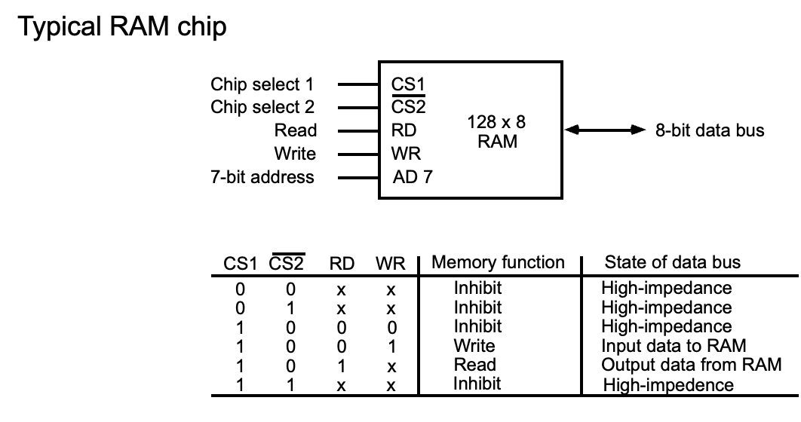
The capacity of memory is 128 words of eight bits (one byte) per word.
This requires a 7-bit address and an 8-bit bidirectional data bus.
The read and write inputs specify the memory operation.
The two chips select (CS) control inputs are enabling the chip only when it is selected by the microprocessor.
The unit is in operation only when CS1 = 1 and CS2 = 0.

Slide 13
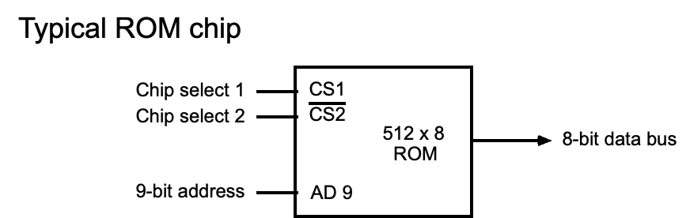
ROM can only perform read operation; the data bus can only operate in an output mode.
The 9-bit address lines in the ROM chip specify any one of the 512 bytes stored in it.
CS1 and CS2 must be 1 and 0 for the unit to operate.
Otherwise, data bus is said to be in a high-impedance state.

Slide 14
SRAM vs. DRAM
SRAM
Uses transistor to store single bit of data.
Faster as it does not need periodic refresh to maintain data.
Faster because bit lines are actively driven by the D-Latch.
Larger area(complex structure) for each cell which means less capacity.
Used for cache memory where speed/latency is key.
Expensive
DRAM
Uses capacitor to store each bit of data.
Slower as they need periodic refresh to maintain charge in the capacitors.
Slower because passive value (charge on capacitor) drives BL.
Small area(simpler structure) means greater density of cells, thus large capacity.
Used for main memory where density is key.
Less expensive

Slide 15
Cache Memory
Cache is a fast smaller memory, placed between CPU & main memory. It stores most frequently accessed data or instructions so that they can be quickly retrieved if required again.
When CPU needs to access memory, cache is examined. If the word is found in cache, it is read from the cache(hit) else the main memory is accessed to read the word(miss).
Performance of cache is measured by Hit ratio which is the number of hits by the total CPU references to memory.
By reducing costly reads and writes that access the slower main memory, caching has an enormous impact on the performance of CPU.
The first caches were off-chip/external, later replaced by on-chip cache memories typically made from SRAM. To further improve the performance, on-chip caches were split into instruction and data partitions.

Slide 16
Locality of Reference
Cache memory works on the principle of locality of reference.
It is the tendency of CPU to access same memory locations as it runs an application.
Ex: When a loop is executed, CPU repeatedly refers to same set of instructions in memory that constitute the loop. Because these memory accesses are predictable, they can be exploited via caching.
Locality is divided into
  Temporal Locality - says that if a program accesses one memory address, there is a good chance that it will access the same address again, i.e., reuse of specific data items within a short time frame.
  Spatial Locality - says that if a program accesses one memory address, there is a good chance that it will also access other nearby/adjacent addresses for the data. This can be result of programmers/compilers clustering items in memory.

Slide 17
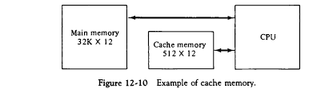
Cache Mapping
The transformation of data from main memory to cache is referred to as Mapping process.
There are three types of mapping procedures
Associative
Direct-mapped
Set associative
Main memory : 32 K x 12 bit word (15 address lines)
Cache memory : 512 x 12 bit word
CPU communicates with both memories
  CPU sends a 15-bit address to cache
  Hit : CPU accepts the 12-bit data from cache
  Miss : CPU reads the data from main memory (then data is written to cache)

Slide 18
Associative mapping
This technique stores both the address and data of the memory word.
This permits any location in cache to store any word from main memory.
The CPU places a 15-bit address in the argument register and the associative memory is searched for a matching address.
If the address is found, the corresponding 12-bit data is read and sent to the CPU.
If no match occurs, the main memory is accessed for the word and the address-data pair is transferred to associative cache memory.
If the cache is full, an address data pair must be displaced to make room for a pair that is needed and not presently in the cache.
This constitutes a first-in first-one (FIFO) replacement policy.

Slide 19
Associative mapping cache
The 15-bit address is shown as a five-digit octal number and its corresponding 12-bit word is shown as a four-digit octal number.

Slide 20
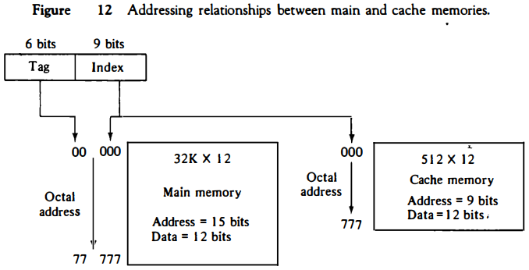
Direct-Mapped
Associative memories are expensive compared to RAM because of the added logic associated with each cell.
This technique uses RAM for the cache. Generally, there are 2^{k} words cache and 2^{n} words main memory.
n-bit memory address: Index field (k-bits) and Tag field (n - k) bits.
n-bit address used to access main memory and k-bit index for cache.
No. of bits in index = No. of address bits required to access cache memory.
15-bit CPU address is divided into: Tag=6-bit(15-9) and Index=9-bit

Slide 21
Direct mapping cache organization
Each word in cache = data word + associated tag.
When a new word is first brought into the cache, the tag bits are stored alongside the data bits.
When CPU generates a memory request, index field is used to access the cache.
The tag field of CPU address is compared with tag in the word read from the cache.
If two tags match, there is a hit and the desired data word is in cache.
If there is no match, there is a miss and the required word is read from main memory.
It is then stored in the cache together with the new tag, replacing the previous value.
Disadvantage: If you frequently read different tags with same Index, the speed(hit ratio) will decrease

Slide 22
Suppose, CPU now wants to access the word at address 00000.
The index address is 000, so it is used to access the cache. The two tags are then compared.
The cache tag is 00 and address tag is 00(Hit) and the data word is read.
If there is a miss, the main memory is accessed and the data word is transferred from MM to cache.

Slide 23
Direct mapping cache with block size of 8 words
Block size = 8 words
Index field : block + word
64 blocks x 8 word = 512 cache words size
Block field = 6 bits, word field = 3-bits
Tag stored in cache is common to all 8-words in each block.
In case of miss, block of 8-words must be transferred from MM to cache.
Though it takes extra time, hit ratio can be improved because of sequential access in computer programs.

Slide 24
Set Associative
Set associative mapping is an improvement over direct mapping in that each word of cache can store two or more words of memory under same index address.
Each data word is stored together with its tag and no. of tag-data items in one word of cache is said to form a set.
An example of set-associative cache for a set size of two is shown.
Each index address refers to two data words and their associated tags.
A set associative cache of set size ‘k’ will accommodate k words of main memory in cache.
When CPU generates a memory request, index of address is used to access cache.
Tag field of CPU address is compared with both tags in the cache to determine if a match occurs.

Slide 25
The comparison logic is done by an associative search of the tags in the set similar to an associative memory search “ thus the name set-associative”
Hit ratio improves with increase in set size as more words with same index but different tags can reside in cache.
In case of a miss and the Set is full, it is necessary to replace one of the tag-data with a new value.
Commonly used replacement algorithms : Random, FIFO and LRU(Least Recently Used)

Slide 26
Replacement Policy
Cache Replacement is implemented between Cache and Main Memory.
When the cache is full then we replace a block (line) of cache with the main memory block.
  First in first out (FIFO) – replace block that has been in the cache longest.
  Least Recently used (LRU) - replace the block that hasn't been used in the longest period of time in the recent.
  Random – randomly selects a block and discards it to make space when necessary. Lower performance than LRU, FIFO.
  Not Applicable on Direct mapping because we fix for each block to come in a particular cache line.

Slide 27
Writing into Cache - write-through method.
The simplest and most commonly used procedure is to update main memory with every memory write operation with cache being updated in parallel if it contains the word at the specified address. This is called the write-through method.
  Advantage: main memory always contains the same data as the cache.
  This characteristic is important in systems with DMA transfers.
  It ensures that the data residing in main memory are valid at all times so that an I/O device communicating through DMA would receive the most recently updated data.

Slide 28
Writing into cache - Write-back method
  In this method only the cache location is updated during a write operation.
  The location is then marked by a flag so that later when the word is removed from the cache it is copied into main memory.
  The reason for the write-back method is that during the time a word resides in the cache, it may be updated several times.
  As long as the word remains in the cache, it does not matter whether the copy in main memory is out of date, since requests from the word are filled from the cache.
  It is only when the word is displaced from the cache that an accurate copy need be rewritten into main memory.

Slide 29
Virtual Memory
A program needs to be available in main memory for the processor to execute it. However, the amount of main memory is not enough to run all of the programs to run at once.
Virtual memory deals with the main memory size limitations.
  Provides an illusion of having more memory while having a small physical memory
With virtual memory, the program is not seen as single part, instead divided into several parts. The entire program is available in the Auxiliary Memory and the only part that is currently being referenced by the processor need to be available in main memory.

Slide 30
Virtual Memory
Two types of addresses in virtual memory systems
  Virtual addresses–referenced by processes(used by programmer) and set of such addresses the Address Space.
  Physical addresses–describes locations in main memory, set of such locations is called the Memory Space.
  Memory management unit(MMU) - translates virtual address to physical address dynamically via OS managed page table
A virtual memory system provides a mechanism for translating program-generated addresses into correct main memory locations.

Slide 31
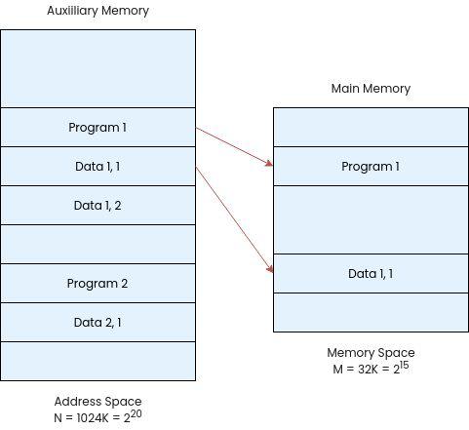
Consider a computer with a main-memory capacity of 32K words (K =1024).
15-bits are needed to specify a physical address in memory, since 32K = 2¹⁵.
Suppose that the computer has available auxiliary memory for storing 2²⁰ = 1024K words.
Thus auxiliary memory has a capacity for storing information equivalent to the capacity of 32 main memories.
Denoting the address space by N and the memory space by M, we then have for this example N = 1024K and M = 32K.
Fig: Relation between address and memory space

Slide 32
In a multiprogramming computer system, programs and data are transferred to and from AM and MM based on demands imposed by the CPU.
Suppose that program 1 is currently being executed in the CPU. Program 1 and a portion of its associated data are moved from auxiliary memory into main memory as shown in Fig.
Portions of programs and data need not be in contiguous locations in memory since information is being moved in and out, and empty spaces may be available in scattered locations in memory.
In our example, the address field of an instruction consists of 20 bits but physical addresses must be specified with only 15 bits.
Thus, CPU will reference instructions and data with a 20-bit address, but the information at this address must be taken from physical memory because access to auxiliary storage for individual words will be too long.

Slide 33
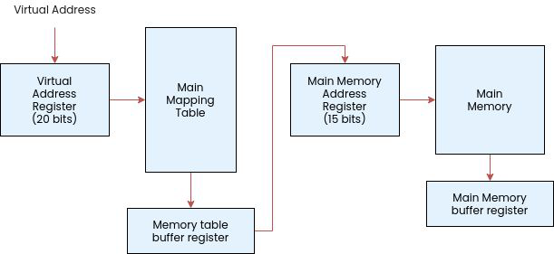
The mapping between the pages and the page frames is called Address Translation and this information is available in a Page Table.
The table implementation of address mapping is simplified if the information in the address space and the memory space are each divided into groups of fixed size.
Virtual address space divided into Pages of fixed size.
  The page number, which is part of the virtual address, is used to index into the appropriate page table entry.
Physical address space divided into Blocks of fixed size also called as Page Frames.
Fig: Memory table for mapping virtual address

Slide 34
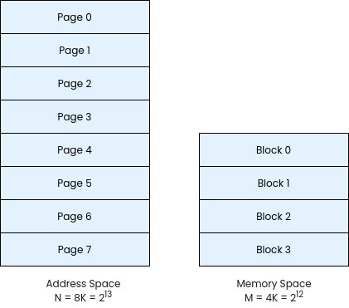
Consider a computer system with Address space = 8K, Memory space = 4K.
If we split each into groups of 1K words we obtain eight pages and four blocks as shown in figure.
At any given time, up to four pages of address space may reside in main memory in any one of the four blocks.
Fig: Address & Memory space split into group of 1K words

Slide 35
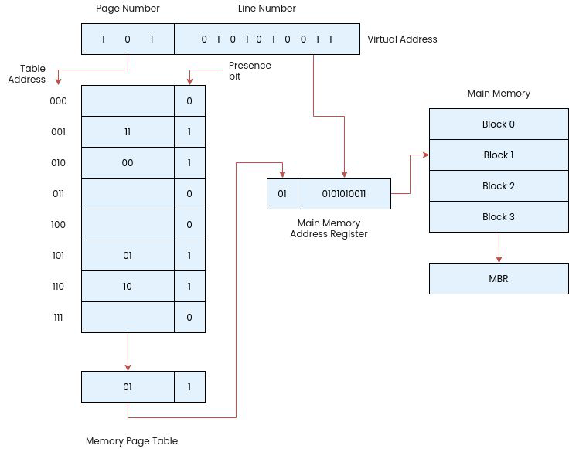
The memory-page table has eight words, one for each page.
The address in the page table denotes the page number and the content of the word gives the block number where that page is stored in main memory.
The table shows that pages 1, 2, 5, and 6 are now available in main memory in blocks 3, 0, 1, and 2, respectively.
A presence bit in each location indicates whether the page has been transferred from auxiliary memory into main memory.
‘ 0 ’ in the presence bit – page not available in main memory.
Fig: Memory table in a paged system

Slide 36
The CPU references a word in memory with a virtual address of 13 bits.
3 high-order bits of virtual address specify page number and also an address for the memory-page table.
The content of the word in the memory page table at the page number address(block number) is read out into the memory table buffer register.
If the presence bit is a 1, the block number thus read is transferred to the two high-order bits of the main memory address register.
The line number from the virtual address is transferred into the 10 low-order bits of the memory address register.
A read signal to main memory transfers the content of the word to the main memory buffer register ready to be used by the CPU.
If the presence bit in the word read from the page table is 0, it signifies that the content of the word referenced by the virtual address does not reside in main memory.

Slide 37
Page fault occurs when the CPU generates an address for a page that is not in physical memory. OS takes control and brings the requested page from secondary storage to main storage.
A page replacement algorithm is used when the memory is full to decide which page needs to be replaced when a new page comes in.
The replacement policies are again FIFO and LRU.

Slide 38
Memory Interleaving
Problem: a single monolithic memory array takes long to access and does not enable multiple accesses in parallel
Goal: Reduce the latency of memory array access and enable multiple accesses in parallel
Idea: Divide the array into multiple banks that can be accessed independently (in the same cycle or in consecutive cycles)
  Each bank is smaller than the entire memory storage
  Accesses to different banks can be overlapped
Memory interleaving(Banking) is used to improve the performance of computer systems by increasing memory bandwidth.
It involves dividing memory into multiple banks and accessing them in a round-robin fashion, which allows for simultaneous access to multiple memory locations and reduces the time required to access data.

